Slide 1
Customer Churn Prediction
Anne Wambua Ireri
Walter Nathaniel Owando

Slide 2
INTRODUCTION
A Telco company wanted to find out the rate at which they are experiencing Customer Attrition.
So they organization shared its data across different states.

Slide 3
The main objective of this study was to develop a predictive model that predicts whether a customer will churn or not.

Slide 4
Data Quality Framework:
Accuracy – the closeness between a value to its correct representation of the real-life phenomenon.
Consistency - the level of compliance for integrity constraints between two or more columns from the same or different table

Slide 5
Timeliness - freshness of the data for a specific application
Completeness – The extent to which data are of sufficient breadth, depth, and scope for the task at hand is evaluated
Unique – This dimension captures the number of duplicated records.

Slide 6
Exploratory Data Analysis
We had 4,250 entries and 20 features on the training data and 750 entries and 20 features on our validation data.

Slide 7
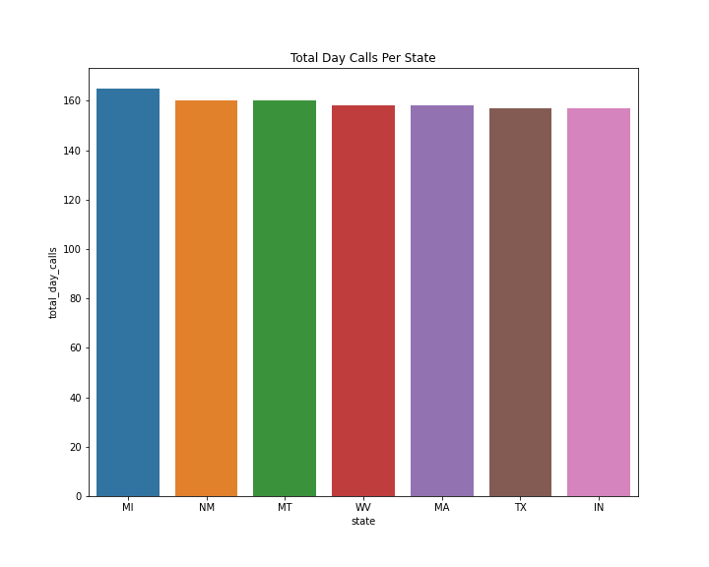
Total day calls per state

Slide 8
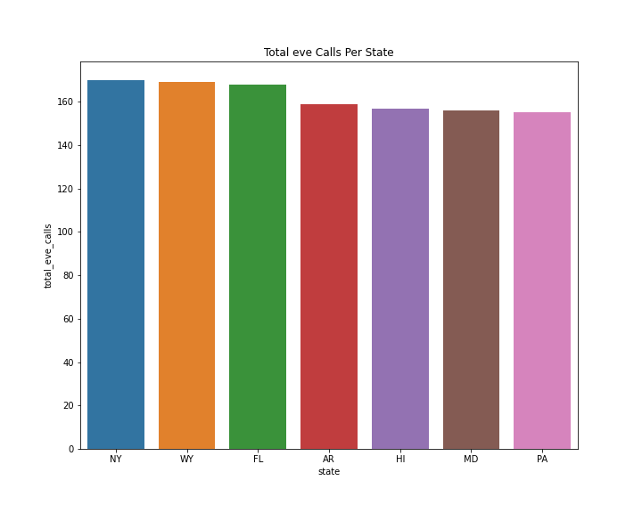
Total evening calls per state

Slide 9
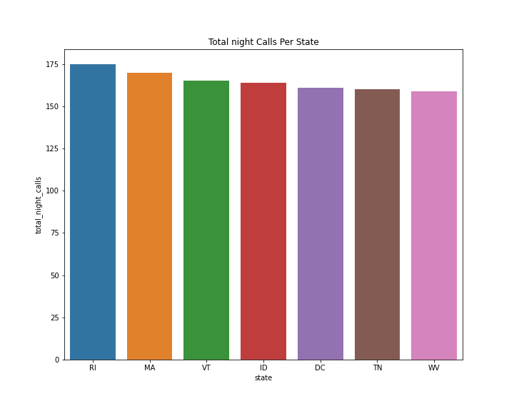
Total night calls per state

Slide 10
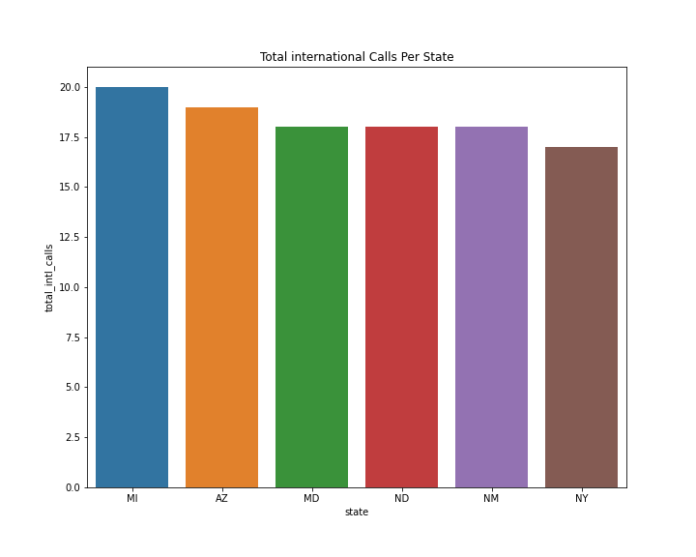
Total International calls per state

Slide 11
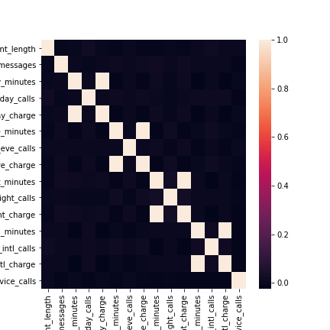
The correlation of our features fall between 0 to 0.1. This means that our data has a weak correlation

Slide 12
Pair-plot with churn as hue

Slide 13
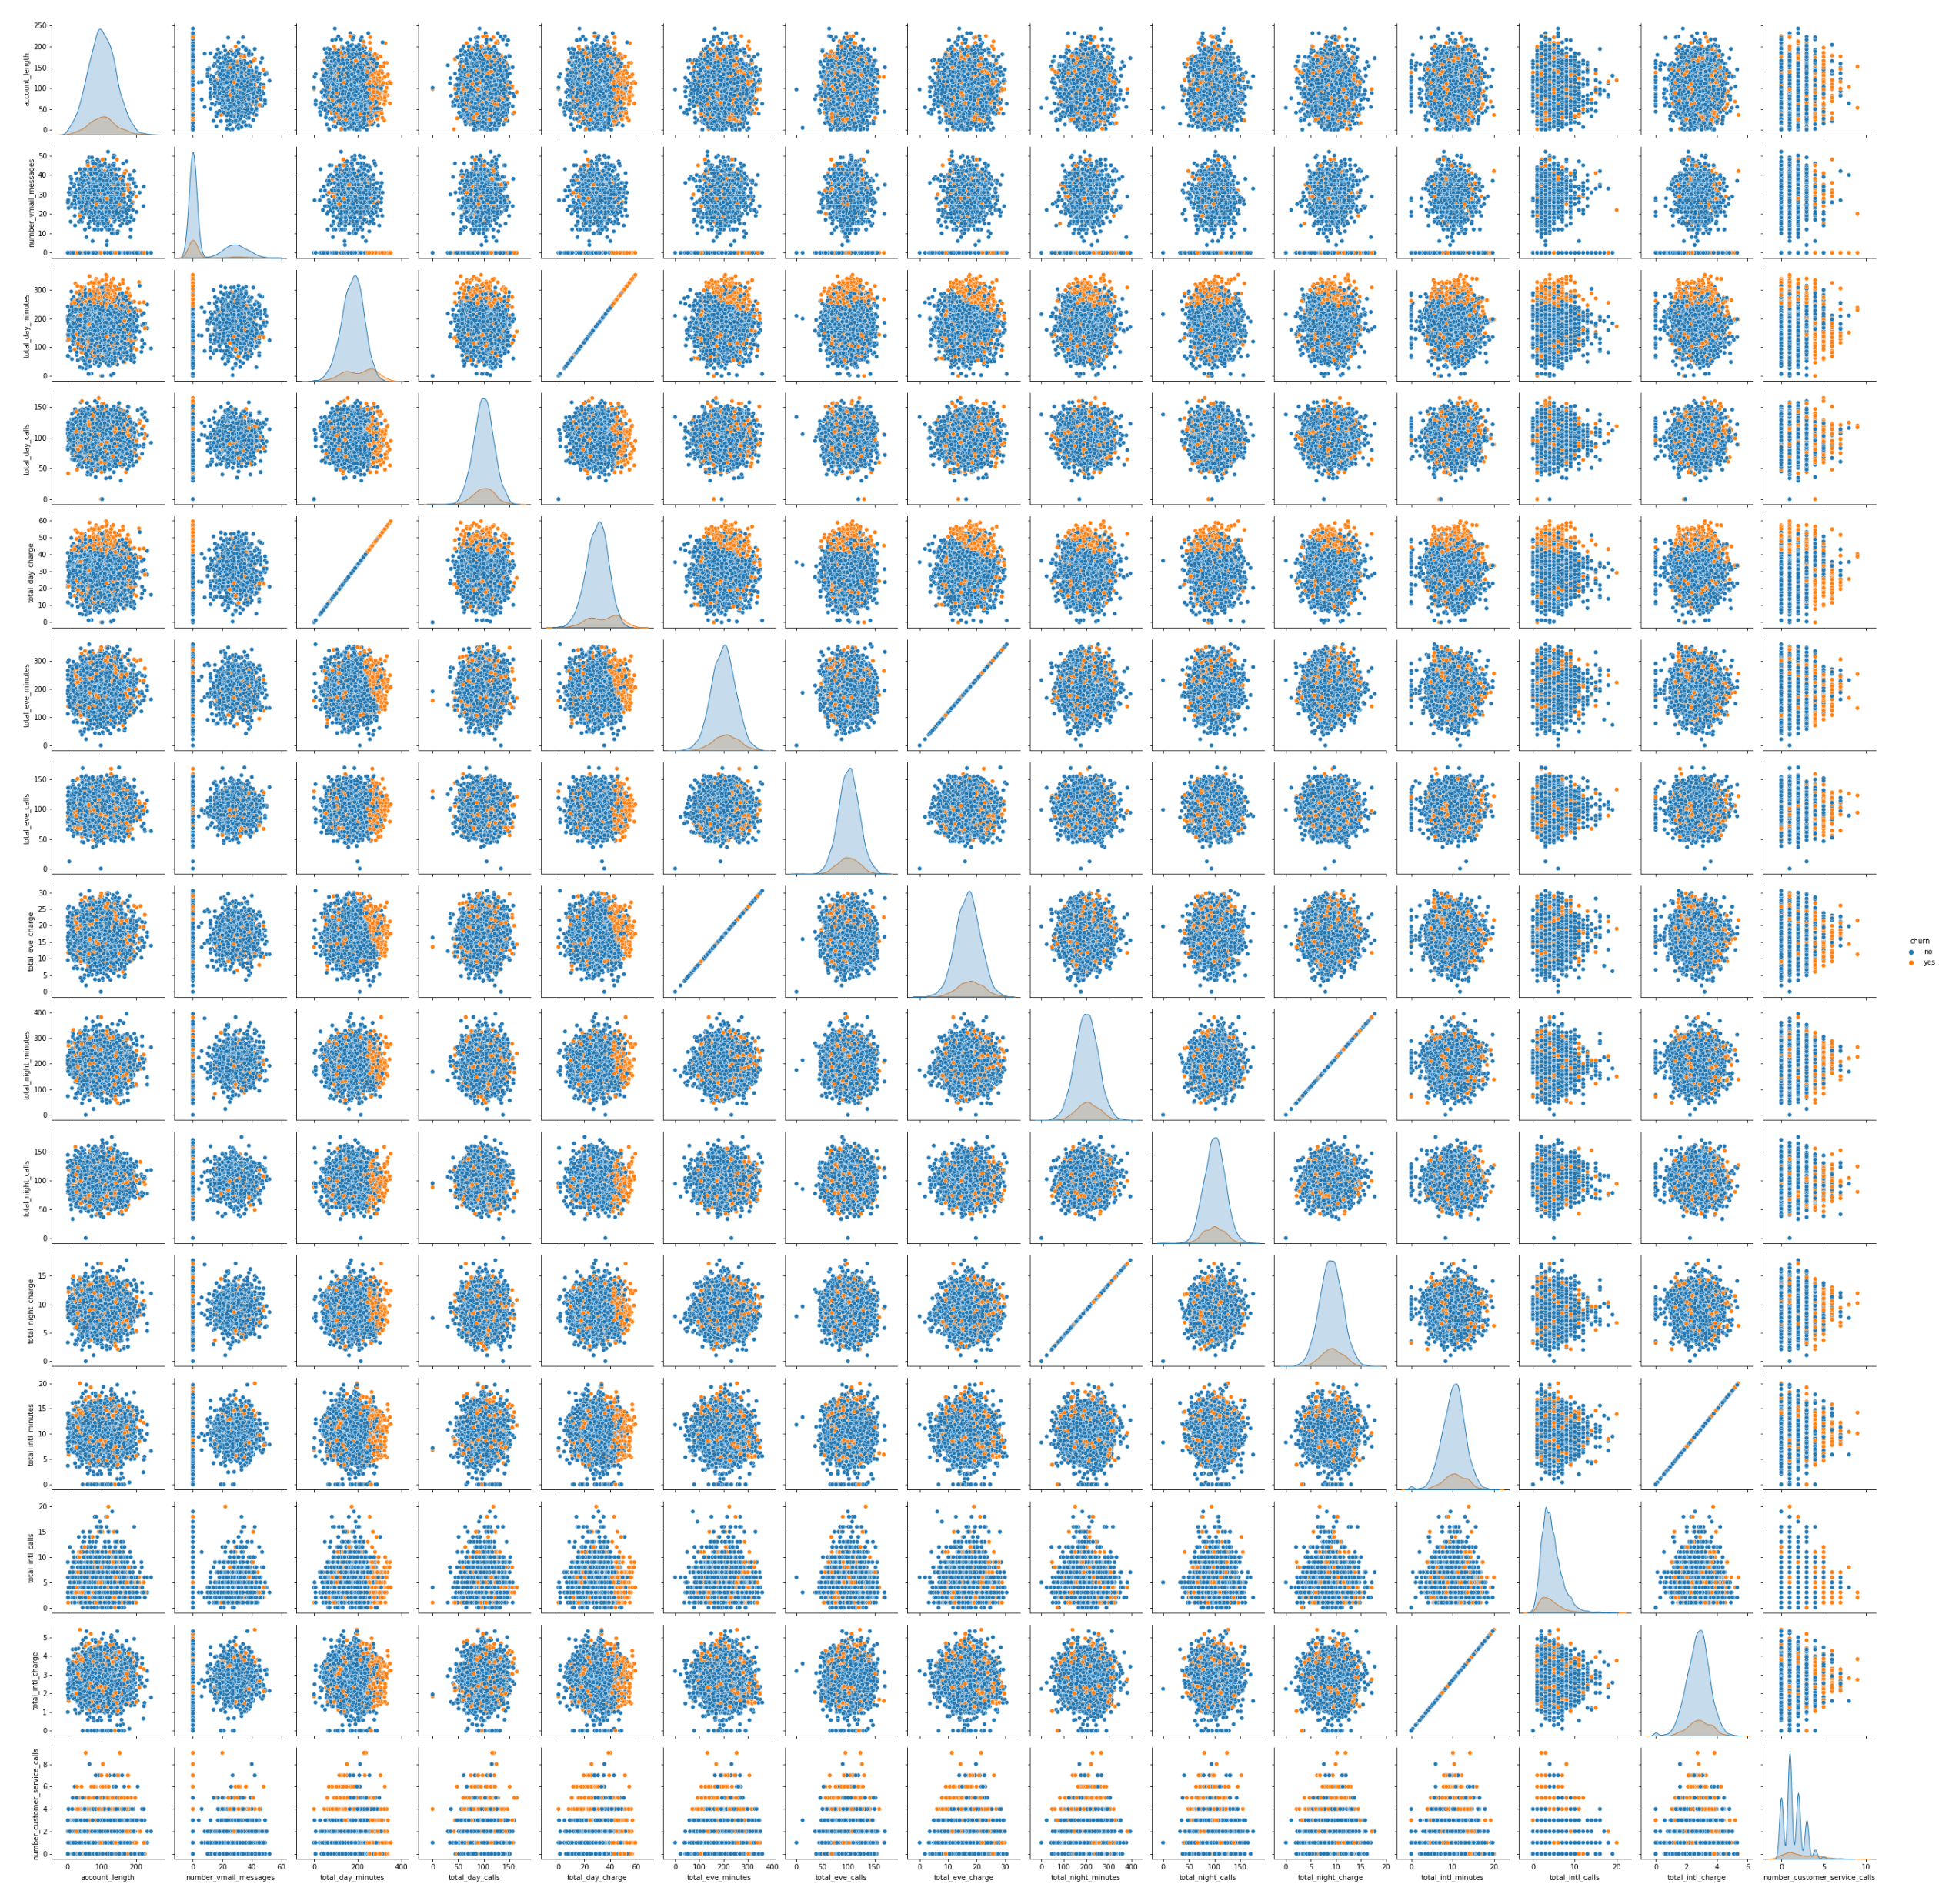

Slide 14
Summary of the Means and Medians of our data

Slide 15
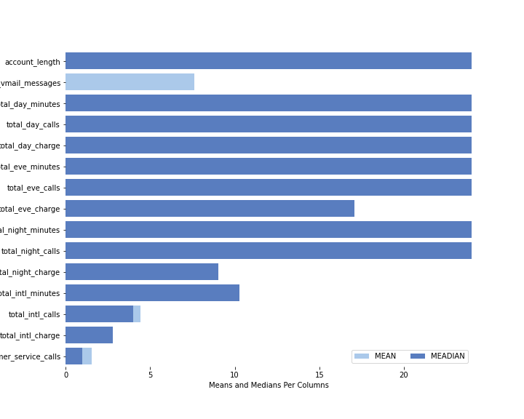

Slide 16
From descriptive statistic, we noticed that almost all the means and medians of features were equal.
This gave the impression that our data follows a gaussian distribution and that it is symmetrical.

Slide 17
Feature Engineering:
Label encoding – Done of categorical features
Normalizing data – where standard scaler was applied

Slide 18
Models Used
MLP Classifier
Random Forest Classifier
Gaussian NB (Naïve Bayes)
Support Vector Machine
XGBClassifier
XGBRFClassifier
GaussianProcessClassifier

Slide 19
Metrics Used
Accuracy
Confusion Matrix

Slide 20
MLP Classifier
Accuracy = 90.47%
Precision = 91%
Recall = 98%
Gaussian NB (Naïve Bayes)
Accuracy = 95.29%
Precision = 92%
Recall = 63%
Random Forest Classifier
Accuracy = 95.18%
Precision = 95%
Recall =100%
Support Vector Classifier
Accuracy = 88.12%
Precision = 87%
Recall = 100%

Slide 21
XGBRFClassifier
Accuracy = 91.41%
Precision = 92%
Recall = 99%
Gaussian Process Classifier
Accuracy = 83.88%
Precision = 88%
Recall = 92%
XGBClassifier
Accuracy = 96.70%
Precision = 96%
Recall = 100%

Slide 22
Conclusions
XGBoostClassifier is the best model since it has a recall of 100% and an accuracy of 96.7% on test data.
Recommendations
More historical data
Add more feature data e.g Demographic Data

